Slide 1


TYPES OF CONTROLLERS
BY SUPRAJA
EMP ID:6142
BATCH-89

Slide 2

TYPES
Sampler controller
Logic controller

Slide 3
SAMPLER CONTROLLER
Samplers are the components which allow JMeter to send specific types of requests to a server. It simulates a user's request for a page to the target server.
Samplers are must to add component to a test plan as only it can let JMeter know what type of request need to go to a server.

Slide 4
Requests could be
FTP Request
HTTP Request (can be used for SOAP or REST Webservice also)
JDBC Request
Java object request
JMS request
JUnit Test request
LDAP Request
Mail request
OS Process request
TCP request

Slide 5
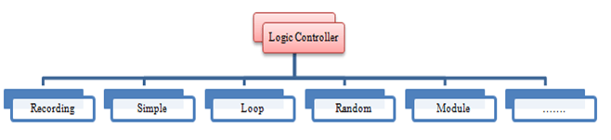
LOGIC CONTROLLER​
Logic Controllers determine the order in which user request is executed.

Slide 6
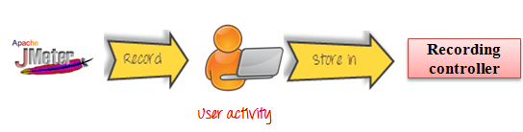
Recording Controller
JMeter can record your Testing steps; a recording controller is a placeholder to store these recording steps.

Slide 7
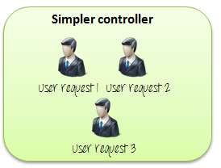
Simple Controller
Simple Controller is just a container for user request.

Slide 8
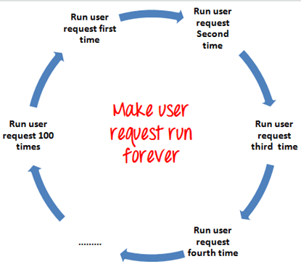
Loop Controller:
Loop Controller makes the user request run a specified number of times or run forever.

Slide 9
In sequential order, requests are sent sequentially in following order:
HTTP request ->FTP request->JDBC request
for each loop.
In random order, requests are sent as randomly,
FTP request ->HTTP request->JDBC request
Or
JDBC request ->FTP request->HTTP request
For each loop.

Slide 10
Random Controller
Random Controller makes all the user requests run in the random order in each loop period.
For example, you have 3 user requests to website http://www.google.com in following order:
HTTP request
FTP request
JDBC request
These 3 requests should run 5 times. Total 15 user requests will be sent to Google server by JMeter.

Slide 11
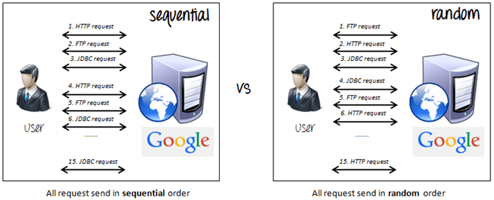

Slide 12
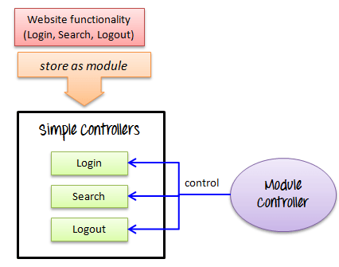
Module Controller
The goal of Module Controller is to add modularity to JMeter.
The general idea is that web applications consist of small units of functionality (I.e. Logon, Create Account, Logoff…). This functionality can be stored in Simple Controller as “modules”. Module Controller will choose which module needs to run.

Slide 13



THANK YOU

